Slide 1
NHS login
Linking to “Manage NHS login Settings” Page
Version 1.0

Slide 2
Introduction - Managing NHS login
NHS login provides capability for users to change their NHS login account settings online, help reducing calls into partner service support desks. To help users do this NHS login needs partner services to create a link from their service to the NHS login settings page. Users will need to be logged into the partner service to use this link.
NHS login currently allows users to:
change their email address
change their password
change their mobile phone number
delete their NHS login

Slide 3
Technical Details
NHS login supports the parameter asserted_login_identity as part of the OIDC flow. This allows the user to seamlessly access the “Manage NHS login Settings” functionality from the partner service without the need for re-authentication.
asserted_login_identity will be a querystring parameter
parameter content is a signed jwt
the asserted_login_identity token is a one-time token(TTL 60 sec)
Refer to the NHS login Interface Specification – Federation document for technical details. In the context of document :
RP1 is partner service
RP2 is NHS login

Slide 4
Technical Details - Parameter : asserted_login_identity
Parameter | Description
asserted_login_identity | The purpose of this parameter is to support seamless login between two RPs (RP1 and RP2) where cookie-based SSO is not available. The content will be a signed jwt with payload containing “code” attribute with the value being that of the “jti” attribute from the ID Token issued to RP1. The jwt “iss” attribute MUST contain the client_id of RP1, the jwt MUST have an “exp” of no longer that 60 seconds, MUST have “jti” and “iat” attributes (as per RFC7519) and MUST be signed by RP1 using its client private key. RP1 passes the jwt to RP2 for RP2 to use in its authentication request. A non-normative example jwt payload section is as follows { code: “eeroifoteiwrudjdwusdu”, iss: “client1”, jti: “reioteotijdvorijevoihroi”, iat: 1548701645, exp: 1548701705 }
Note : Please refer to NHS login Interface Specification – Federation document, for most up-to-date technical details.

Slide 5
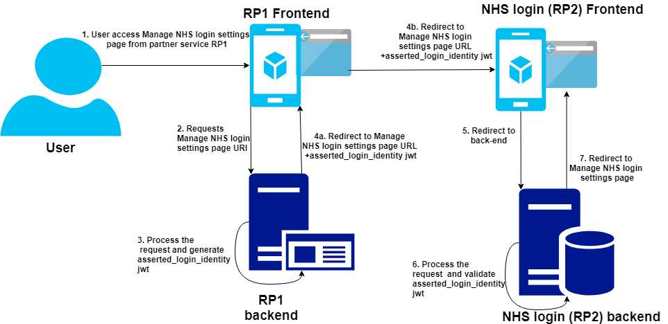
Technical Details : Flow Diagram

Slide 6
Settings Page Link Details
Production URL:
https://settings.login.nhs.uk?asserted_login_identity=ewrffw...wfw
Other Environments URL:
https://settings/<ENV>.login.nhs.uk?asserted_login_identity=ewrffw...wfw

Slide 7
Other Information
Any UX related guidance ?

